Slide 1

Presentation on
DIGITAL SOLUTION TO INTEGRATE THE SCHOLARSHIP SCHEME WITH PERFORMANCE
by
S SIVANANDA REDDY
DEPARTMENT OF MASTER OF COMPUTER APPLICATIONS
SREE VIDYANIKETHAN ENGINEERING COLLEGE
(An autonomous institution affiliated to JNTUA, Anantapuramu)
SreeSainath Nagar, Tirupati – 517 102.

Slide 2
ABSTRACT
In this project, government needs to constantly monitor the academic progress of beneficiary’s right of scholarship from primary level to the post graduation level in order to link their academic progress with scholarship scheme on a digital platform. Consider set of criteria's to issue scholarships for the students, who satisfy criteria can be beneficiars of the scholarship scheme. Here we have three academic criteria's such as 75%-85% , 85% -90% and 90% above should get three category schemes of scholarships respectively. Hence, the students who are eligible for scholarship they must process the above said criteria.

Slide 3
LITERTURE SURVEY
WWW.INSPIRE.GOV.IN
In this scheme the government provides scholarships only for top 3 students in a state wide .This scheme only focus on science and research & development .This scheme applicable from board level to UG level.
WWW.EPASS.GOV.IN
Students who belongs to categories of SC,ST whose annual income is two lakhs or below and BC ,EBC,disabled welfare students whose parental income one lakh or below.
In this scheme the merit students are not benificiars .This scheme only focus on the community and financial positions but not the talent of the students.
WWW.SCHOLORSHIP.POSITION.COM
Presently there are various financial aids and scholarships for women around the world .Scholarships for women are available at all degree level that is UG , PG and PHD .
This scheme only applicable for only women/girls students .This scheme also does not consider any academic percentages .This scholarships useful for only for girls but not the male students

Slide 4
WWW.MHRD.GOV.IN
The national merit scheme the objectives of which was to provide financial assistance to merit studentsThis scheme applicable from board level to it is based on merit but not from the school level .In school level also so many merit students are there but they are not benefit for any scholarships.
By analyzing the above scholarships schemes we find above disadvantages .By overcome these problems we have to implement one new scheme i.e. PERFORMANCE BASED SCHOLARSHIPS.

Slide 5
PROBLEM DEFINITION
The main objective of this project is to provide the scholarship based on their performance .In this scheme the scholarships based purely on their academic performance and does not consider any community or financial positions .In this scheme the scholarships are provided from primary level to post graduation level .By implementing this scheme the students are also more concentrate on their academics.

Slide 6
EXISTING SYSTEM :
Many existing schemes provide scholarship based on financial or community wise. Even some schemes provide based on merit wise but they are not provide from the primary level.
Through this existing system the students efficiency cannot be measured.Because the scholarships are not given based on the performance.

Slide 7
PROPOSED SYSTEM :
Through this proposed system the students receives the scholarship purely based on talent and students also focus more towards their academic progress in order to receive the scholarships. students will be motivated and try to work harder in order to get scholarships.

Slide 8
FEASIBILITY STUDY
Technical Feasibility
Operation Feasibility
Economical Feasibility
Technical Feasibility:
Since the project is designed with Java with HTML as front end and oracle is back end.
It is easy to install in all the systems wherever needed it is more efficient.

Slide 9
ECONIMICAL FEASIBILITY
In the systems, the organization is most satisfied by economic feasibility because, if the organization implements this system, it need not require any additional hardware and software resources. This System is developed by using open source software like Apache, JAVA used to minimize the cost as well as it will be saving lot of time.
OPERATIONAL FEASIBILITY
Reliability
The package wills pick-up current transactions online. Regarding the old transactions, User will enter them in to the system.
Security
The web server and database server should be protected from hacking, virus etc
Portability
The application will be developed using standard open source software (Except Oracle) like Java, tomcat web server, Internet Explorer Browser etc these software will work both on Windows and Linux o/s. Hence portability problems will not arise.
Availability
This software will be available always.

Slide 10
DATA COLLECTION
There are four different types of techniques that are used to collect the data
Interview method
Questionnaires and survey method
Online observation method
Documents and records

Slide 11
ONLINE METHOD
In our project we are using online method.
It is one method for data collection. In this method we have to search various college websites and get the information that is required in our project. And we have extracted the features that are used in our project.
www.inspire.gov.in
In this scheme the scholarships are sponsored based on the merit. In my project I am using this functionality to provide the scholarships based on their performance. In this inspire scheme is that it does not believe in conducting competitive exams for identification of talent.

Slide 12
www.mhrd.gov.in
The national merit scholarship scheme the objective of which was to provide financial assistance. In this scheme the scholarships are provided from ssc board level. In my project I am using this functionality but I am extending this feature i.e. the scholarships are provided from primary level to PG level
www.mdrc.org
PERFORMANCE BASED SCHOLARSHIPS : What have we leared?
This was the paper published by the Reshma patel, Lashwan Richburg Hayes. The main aim of this scholarship burdens on lo-income students while providing incentives for good academic progress. By the above scheme I am using functionality like the scholarship is to help reduce the financial burdens on low-income students by providing scholarships for good academic progress.

Slide 13
DATA COLLECTION
NAME | ADDRESS | EMAIL | FEATURES
INSPRE | Dept of science & technology, New delhi-110016, Tel no:0120-4676260 | Inspire.prog-dst@nic.in | scholarships provided based on merit wise. it does not conduct any competitive exams
MINISTRY OF HUMAN | Shastribhavan,jeevandeep building new delhi-110001 Tel no:23782698 | Mhrd.gov.in | Scholarships provided from secondary level to PG level
Performance based scholarships “What have we learned” | 16east34th street New york, NY10016-4326 | www.mdrc.org | Reduce the financial burdens on low income students while providing scholarships for good academic progress.

Slide 14
DATA DICTIONARY
SNO | COLUMN NAME | DESCRIPTION | TYPE | SIZE | CONSTRAINT
1 | NAME | User name | Varchar2 | 30 | Not null
2 | Stu-id | Id of student | Varchar2 | 40 | primary key
3 | dob | Birth date | Date | 20 | Not null
4 | password | Security password | Varchar2 | 16 | Not null
5 | Mobile no | User phone no | Number | 10 | Not null
6 | address | Student address | Varchar2 | 20 | Not null
7 | A-name | Admin name | Varchar2 | 20 | Not null
8 | Sch-id | Scholarship id | Varchar2 | 30 | Primary key
9 | email | Email account of student | Varchar2 | 25 | Not null
10 | Documents | Required documents | Varchar2 | 30 | Not null
11 | Inst- name | Name of the institution | Varchar2 | 50 | Not null
12 | Confirm password | Retype password | Varchar2 | 40 | Not null
13 | Inst-id | Id of the college | Varchar2 | 16 | Primary key
14 | A-id | Id of the admin | varchar2 | 16 | Primary key

Slide 15
MODULES
Administration
Adding institution details
Login-registration
update
Issuing Scholarship
Adding student details
Add scholarship details and set the criteria for scholarship
Accept or reject scholarship for students
Student
View all scholarship details and eligibility criteria
Upload scholarship documents
View scholarship status
Send feedback

Slide 16
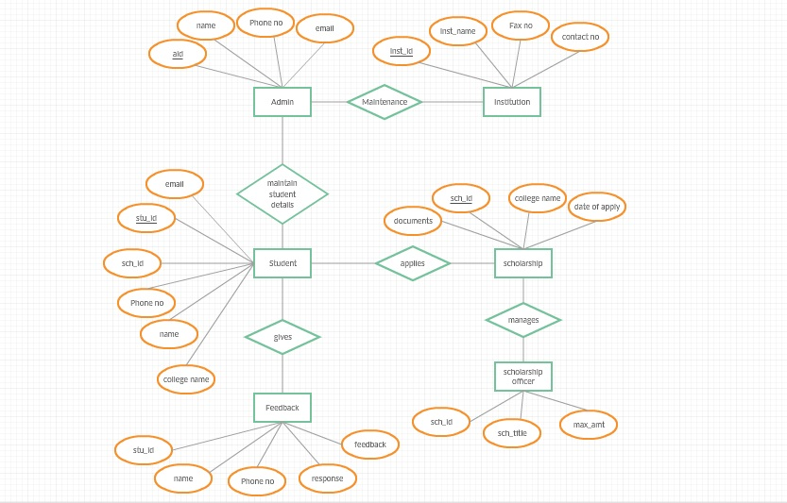
ER-DIAGRAM
FOR PERFORMANCE BASED SCHOLARSHIPS

Slide 17
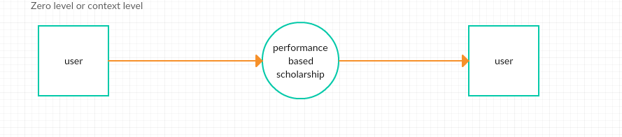
DATA FLOW DIAGRAMS

Slide 18
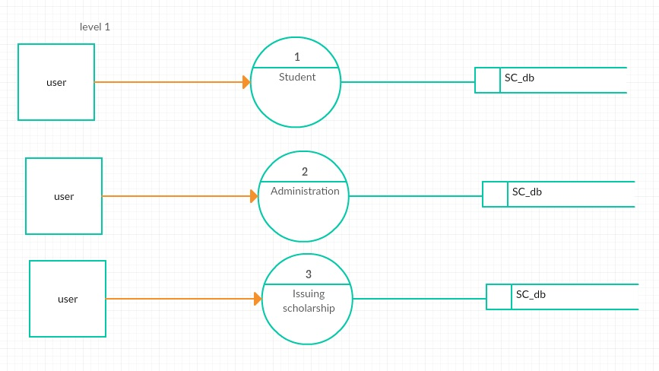
LEVEL-1

Slide 19
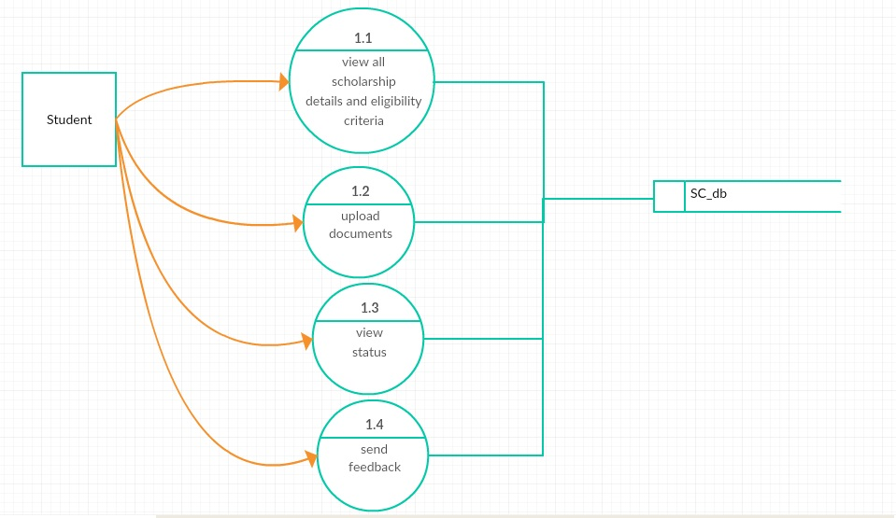
LEVEL-2

Slide 20
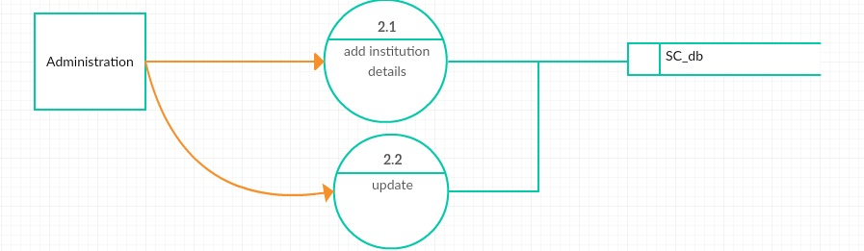

Slide 21
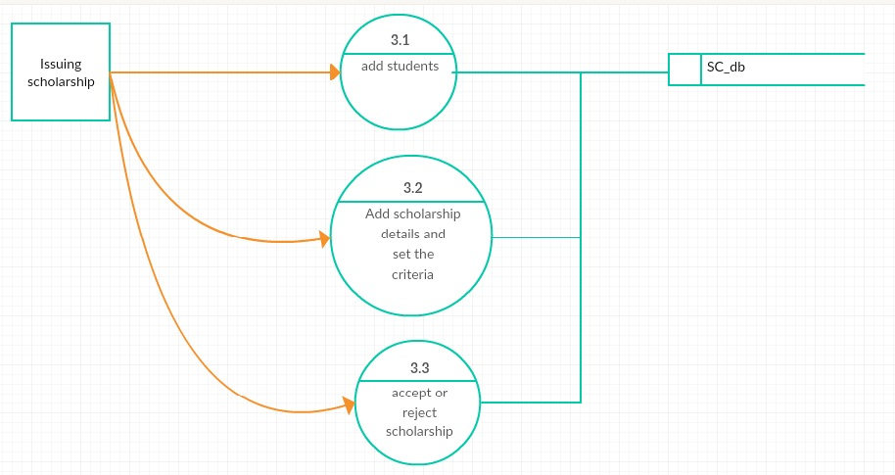

Slide 22
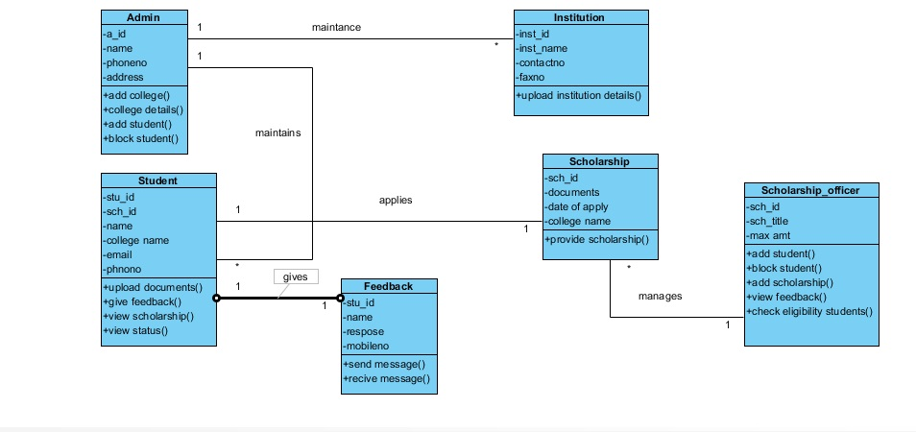
CLASS DIAGRAM

Slide 23
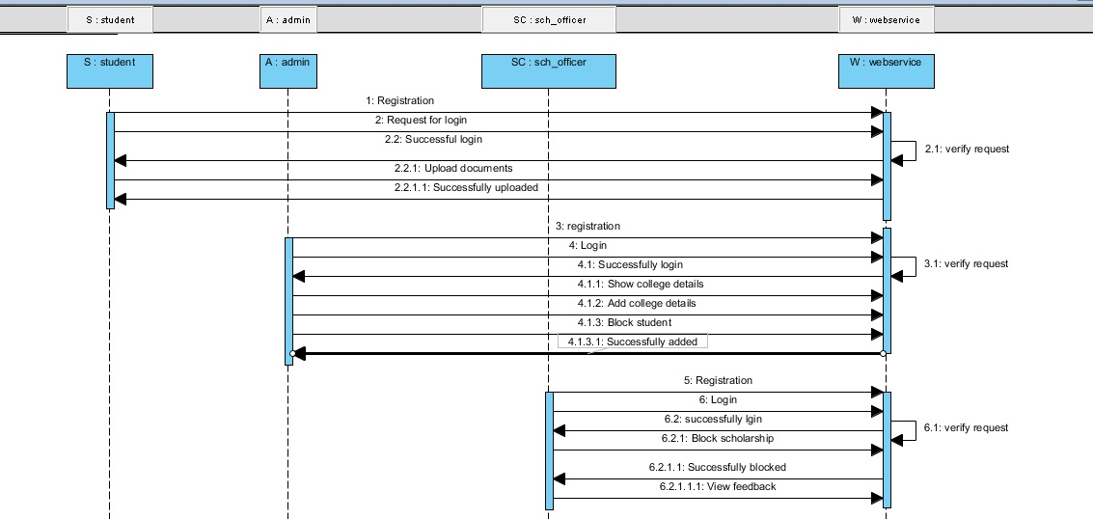
SEQUENCE DIAGRAM

Slide 24
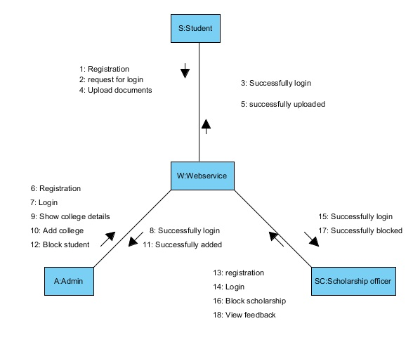
COLLABERATION

Slide 25
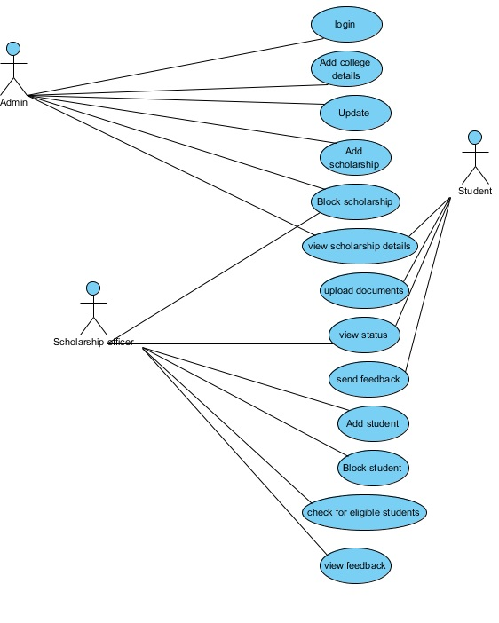
USECASE DIAGRAM

Slide 26
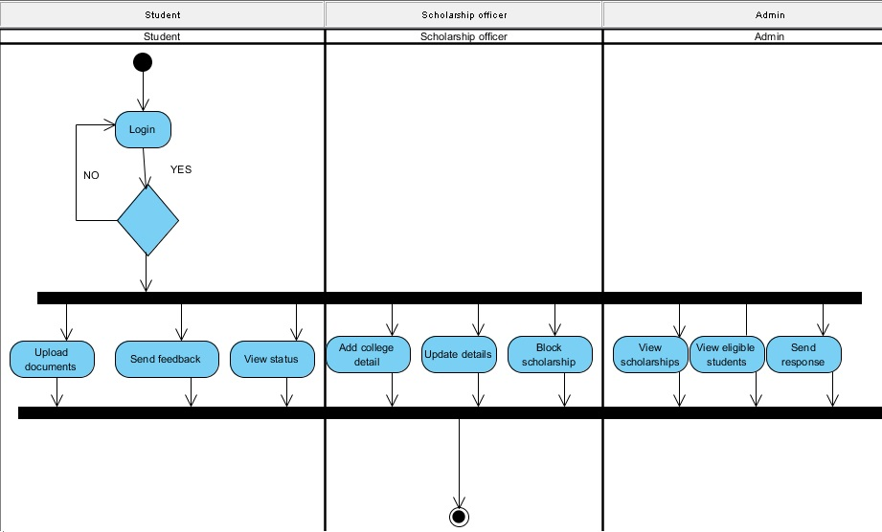
ACTIVITY DIAGRAM

Slide 27
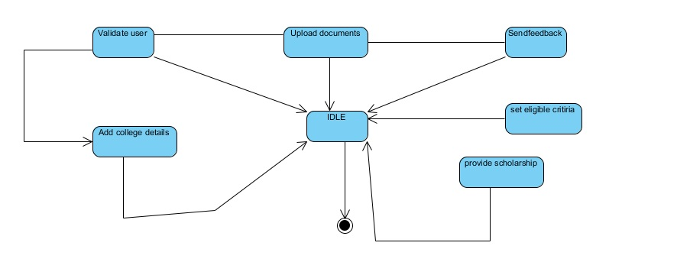
STATECHART DIAGRAM

Slide 28
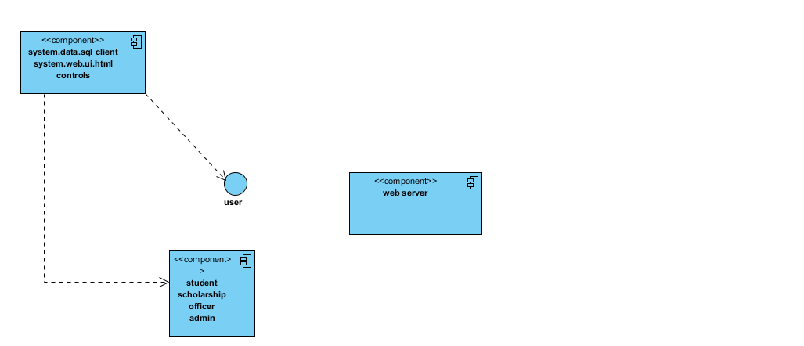
COMPONENT DIAGRAM

Slide 29
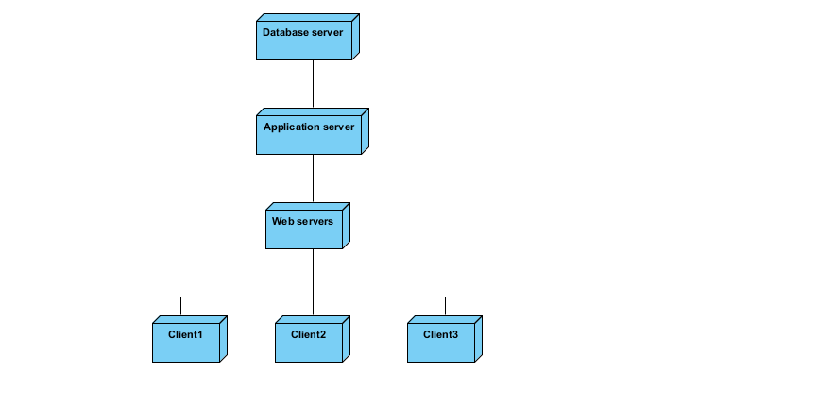
DEPLOYMENT DIAGRAM

Slide 30
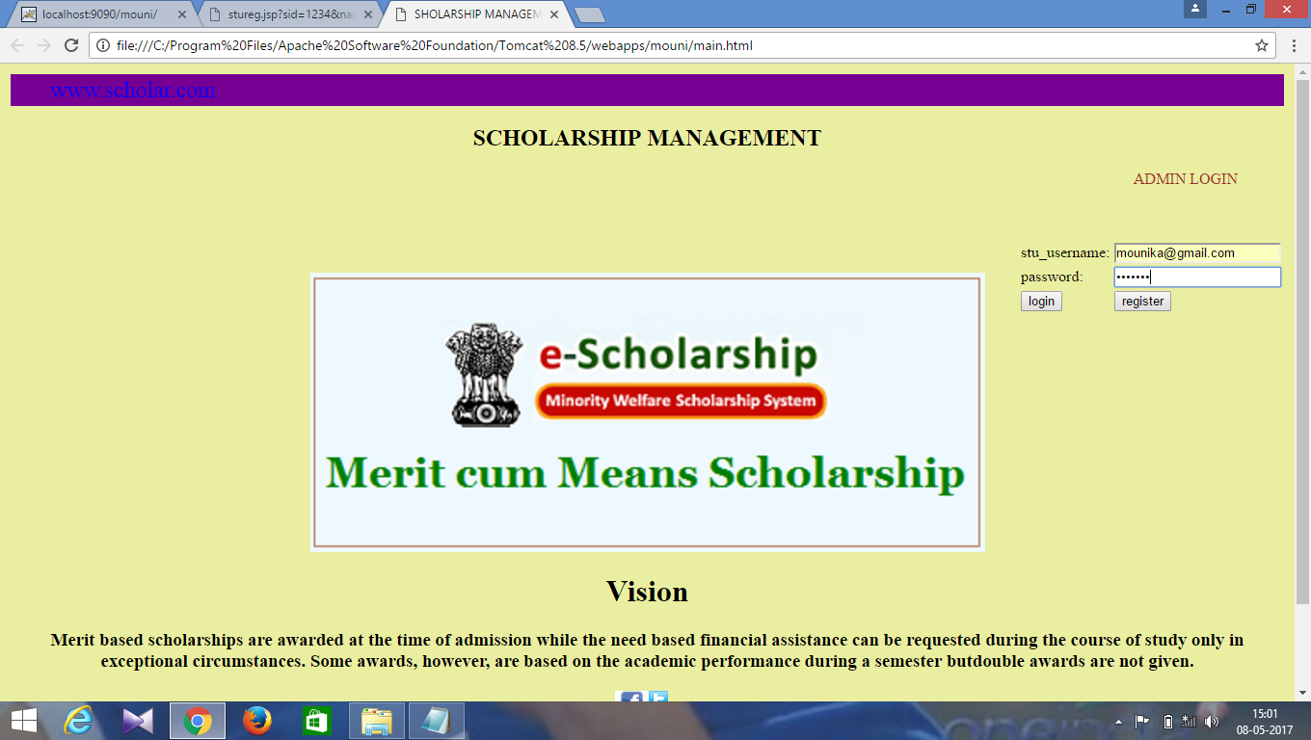
HOME PAGE

Slide 31
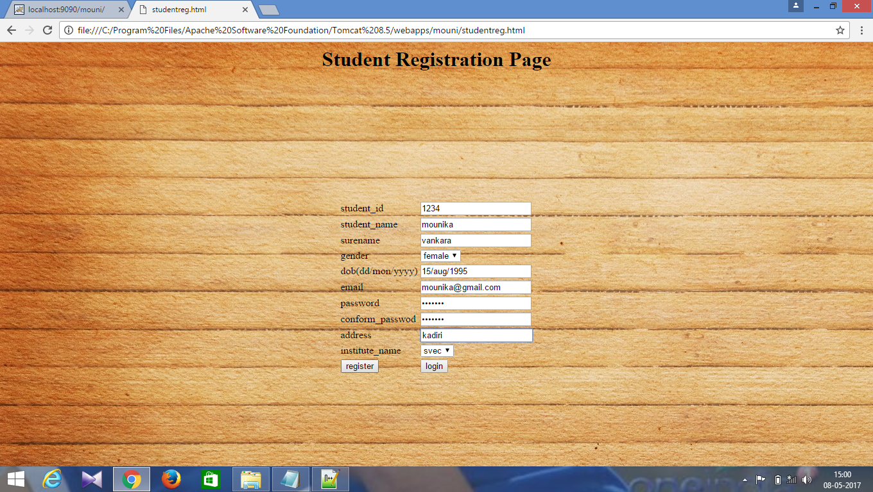
STUDENT REGISTRATION

Slide 32
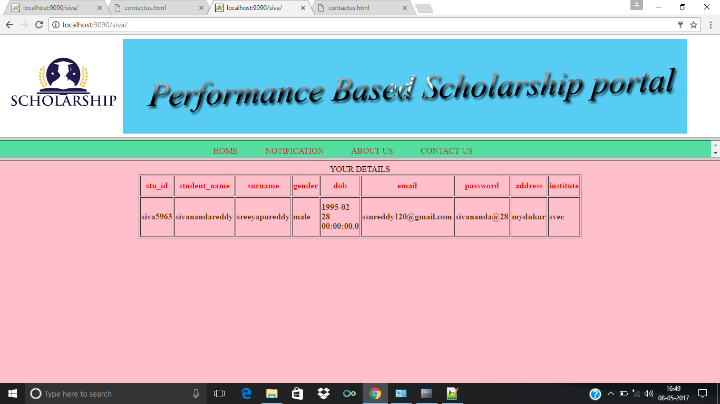
STUDENT VIEW PROFILE

Slide 33
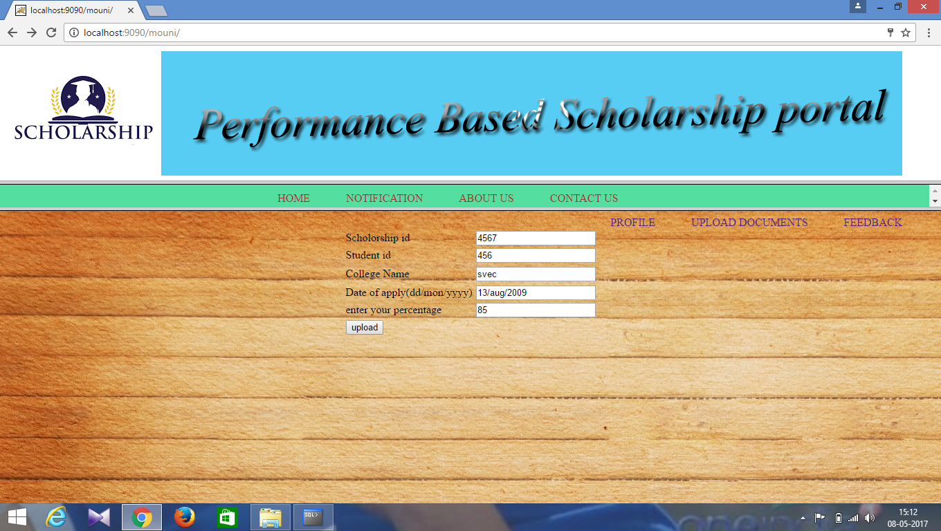
UPLOAD DOCUMENTS

Slide 34
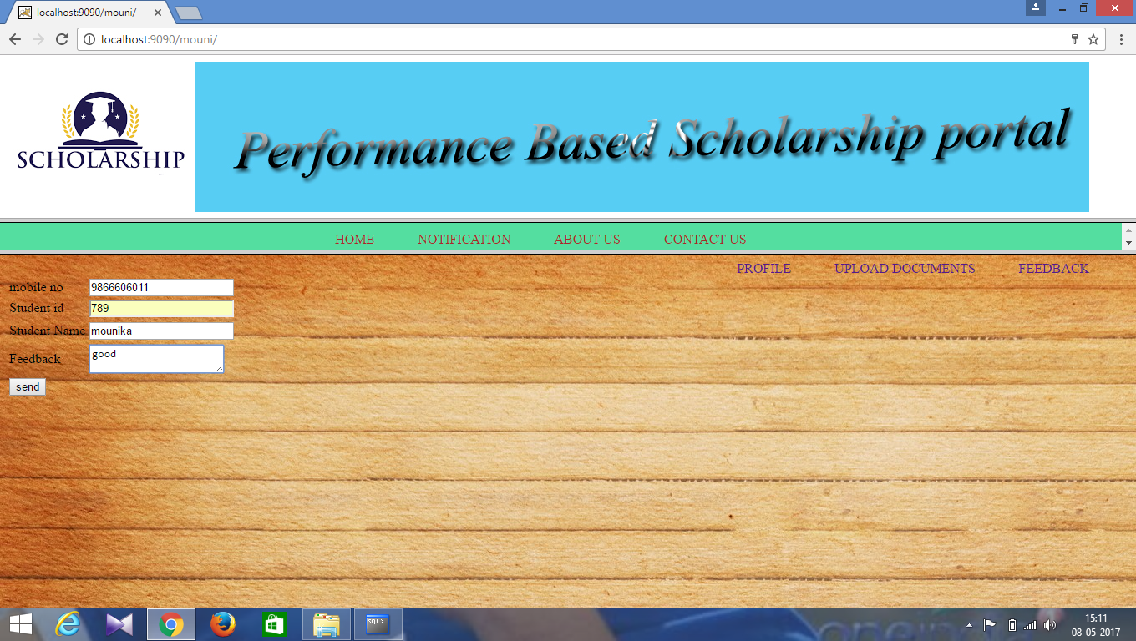
GIVE FEEDBACK

Slide 35
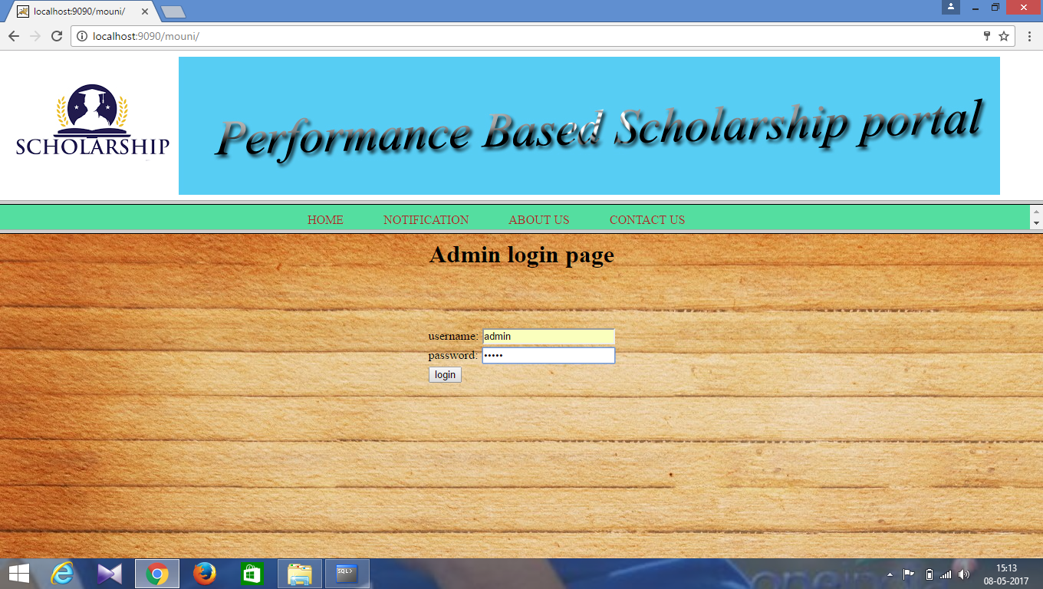
ADMIN LOGIN

Slide 36
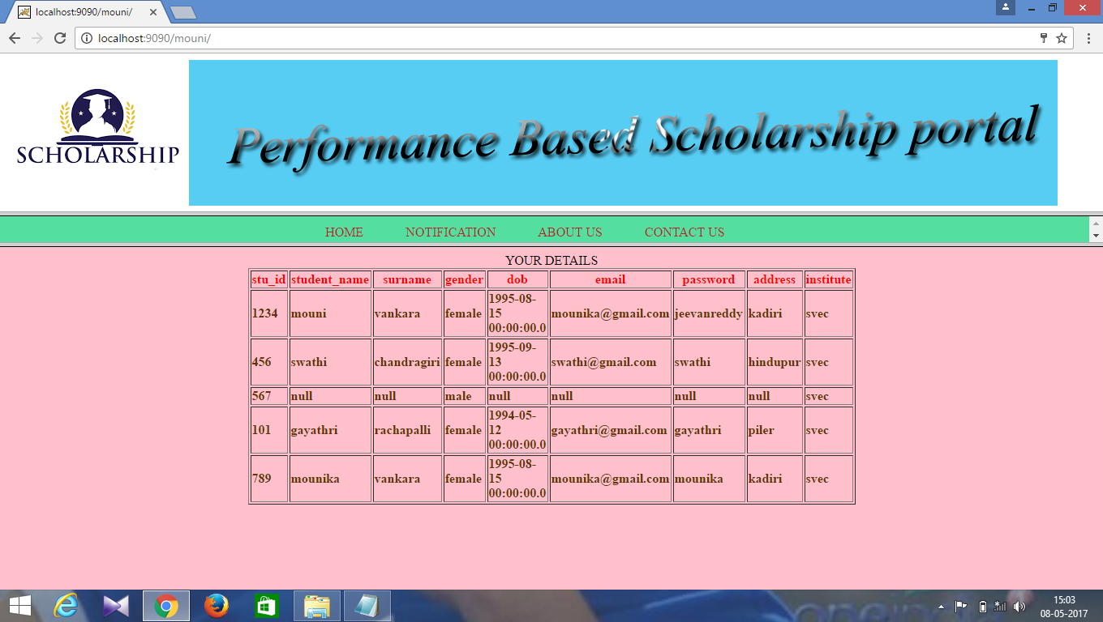
VIEW STUDENT DETAILS

Slide 37
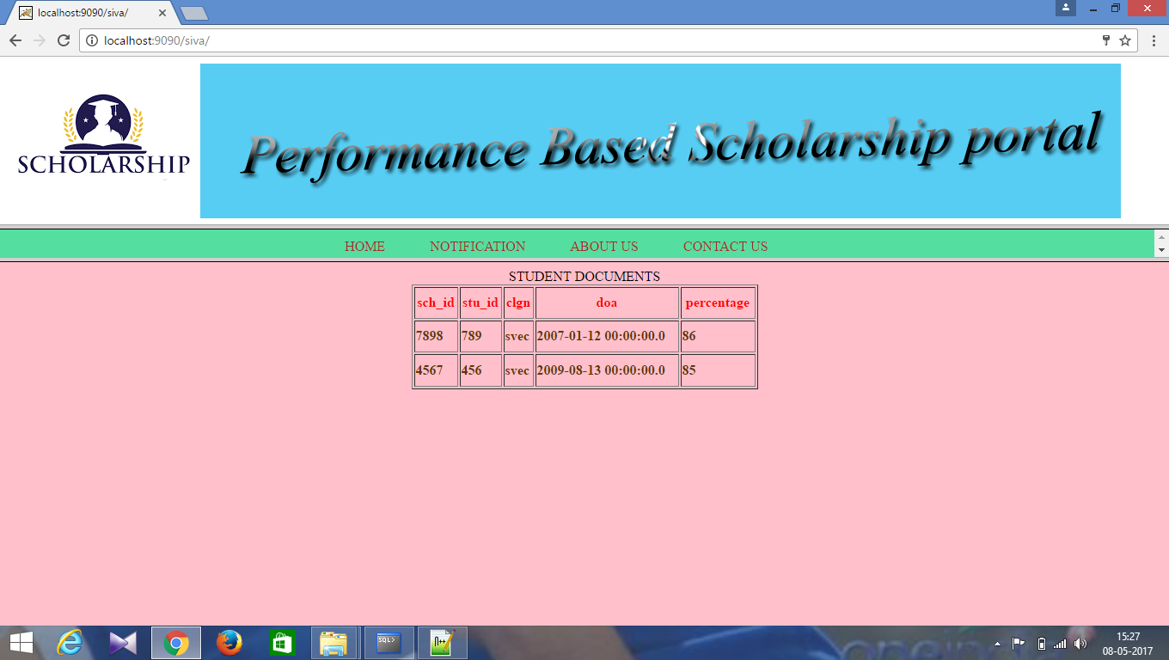
VIEW DOCUMENT DETAILS

Slide 38
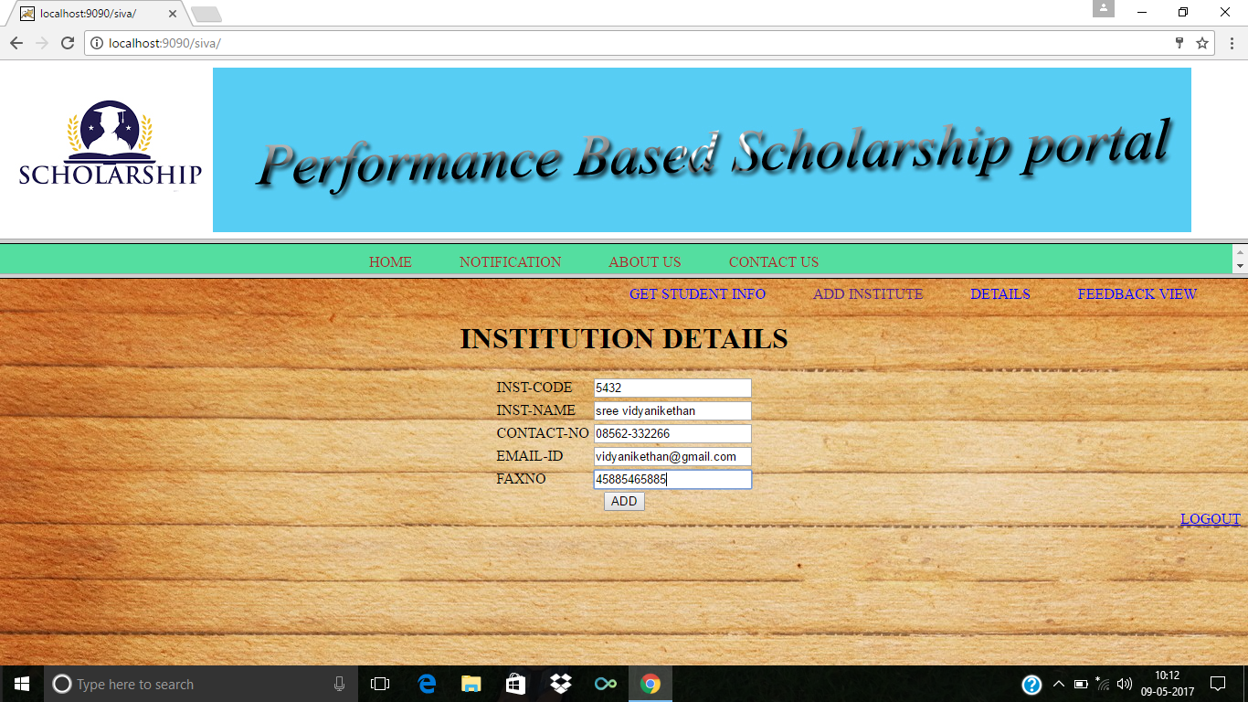
ADD INSTITUTE DETAILS

Slide 39
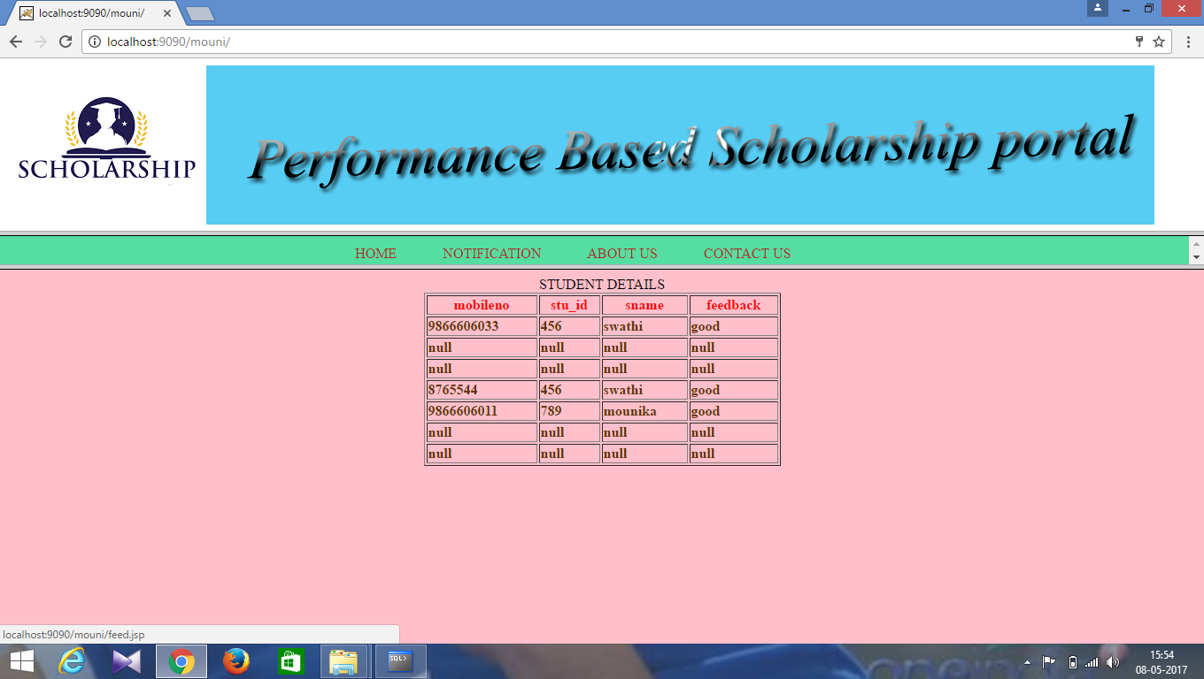
VIEW FEEDBACK

Slide 40


Slide 41
THANK YOU

